Slide 1
Taking India to MARS
The Story behind India’s space programme
Tedx video by Ritu karidhal
Deputy Operations directions

Slide 2
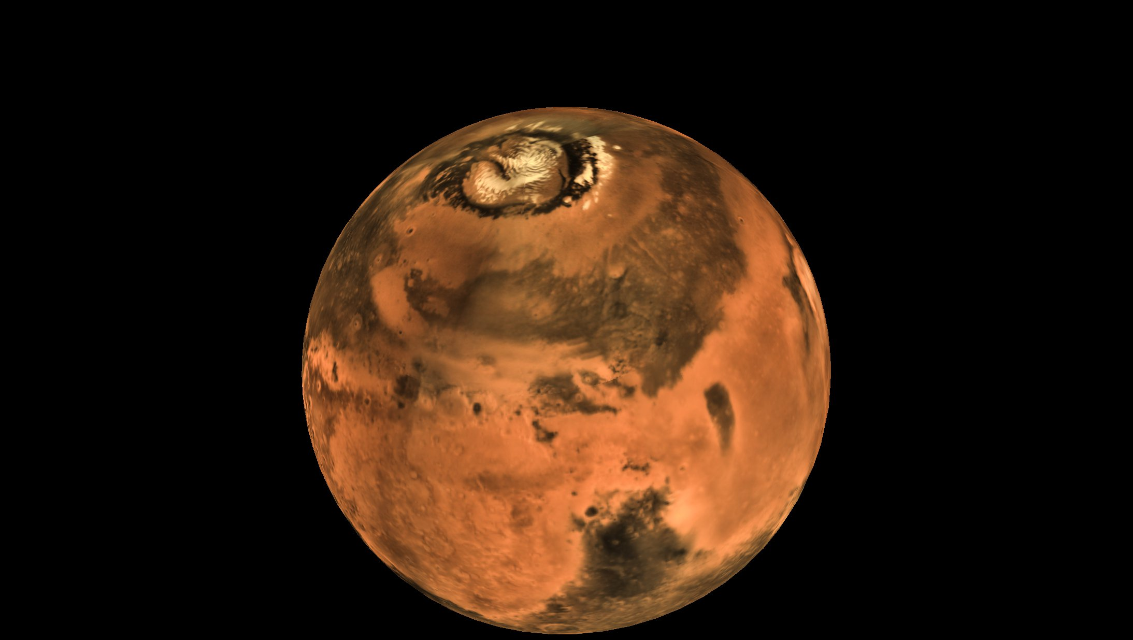
MOM
Mars Orbital Mission

Slide 3
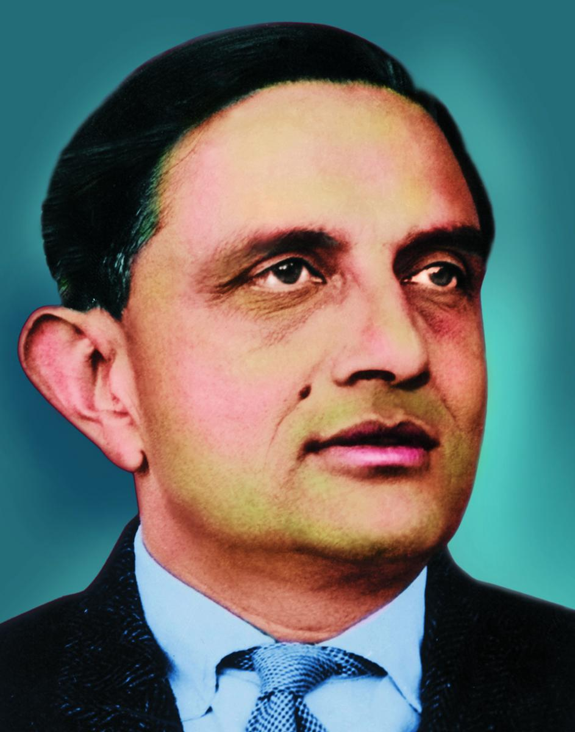
History
ISRO
Dr. Vikram Sarabhai
1960

Slide 4
Facts about MOM
There are some of the real criticle issues with the MOM:
Min distance - 54.6 million kms
Max distance – 401 million kms
4th bullet point
5th bullet point
The sun is in the center of all orbits
There are smaller planets closer to the sun
There is a mix of planet sizes further away

Slide 5
Variables
Controlled variables: These are the things that are kept the same throughout your experiments.
Independent variable: The one variable that you purposely change and test.
Dependent variable: The measure of change observed because of the independent variable. It is important to decide how you are going to measure the change.
Planet | Mass | Period of rotation | Distance from the sun
Mercury
Venus
Earth
Mars
Jupiter
Saturn
Uranus
Neptune

Slide 6
Works Cited
Be sure to include print and electronic sources and put them in alphabetical order.

